Slide 1
Becoming a Data Scientist
Mamadu Bah
Prince Appiah
Dr. Bemley
CTEC 298
12/2/2025

Slide 2

Introduction
This semester, we focused on using Python to clean, analyze, and visualize real-world data. We worked on important topics such as healthcare inequality and fairness within sports. Our goal was to improve our technical skills while learning how to communicate results clearly and professionally.

Slide 3
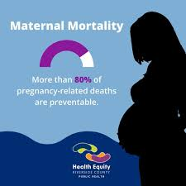
CTEC 128 - Mamadu
Analyzed maternal mortality rates in the U.S.
Compared outcomes for Black, White, and Asian women
Cleaned and organized CDC-based dataset using Python
Revealed that Black women have the highest mortality risk in childbirth
Used data to support conversations about healthcare justice

Slide 4

CTEC 128 - Prince
Studied which athletes are more likely to be drafted into the NFL
Used combine performance and school data
Found that visibility and conference prestige influence outcomes
Showed how talented athletes from smaller schools can be overlooked
Used analytics to identify hidden bias in sports recruitment

Slide 5

What We Learned in CTEC 298
Strengthened Python coding fundamentals
Practiced loops, functions, lists, classes, and dictionaries
Used Pandas for DataFrames and descriptive statistics
Used NumPy for numerical operations and slicing
Worked in Jupyter Notebook to test code interactively

Slide 6
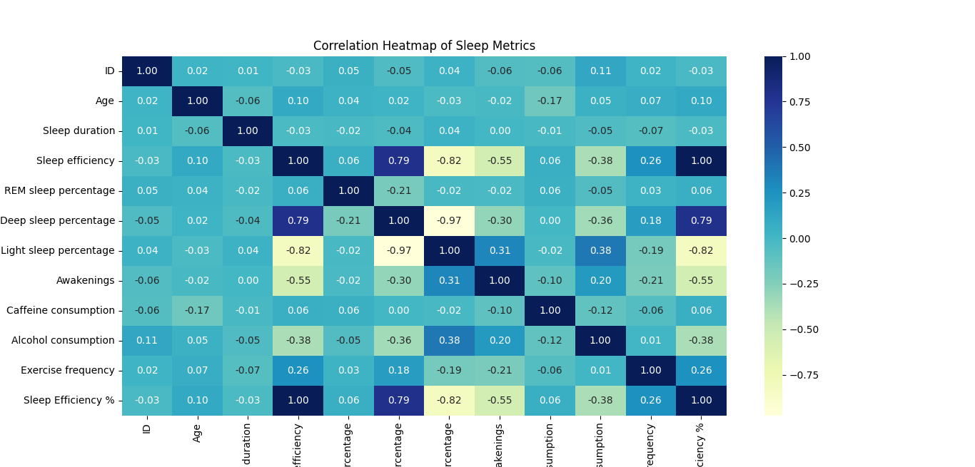
Data Visualization
Created visual charts to support decision-making
Learned how visuals reveal patterns faster than raw tables
Built confidence presenting data clearly and visually

Slide 7
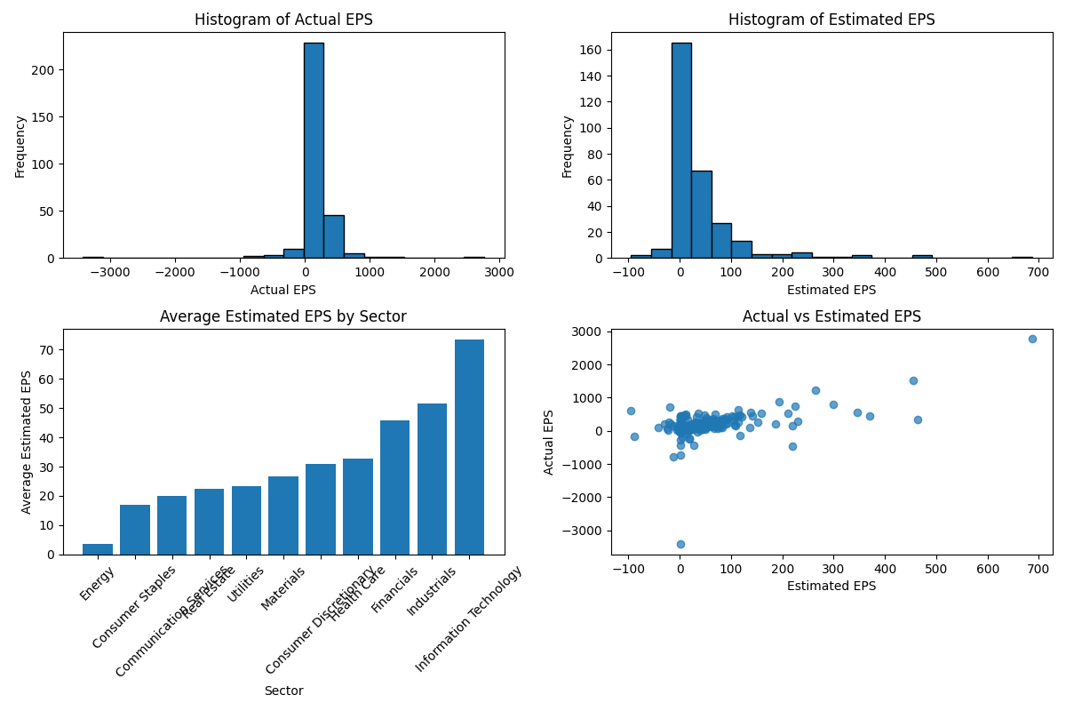
Plot Examples

Slide 8

Why This Matters
Data helps expose inequity, bias, and hidden trends
Analytics can influence change in healthcare and sports
Technology supports smarter decisions and fairer outcomes

Slide 9

Future
Our Python and data analytics skills apply directly to future roles
We can contribute as technical analysts or in tech consulting
Turning information into insights is valuable in every industry
This course prepared us for more advanced projects and careers in tech

Slide 10
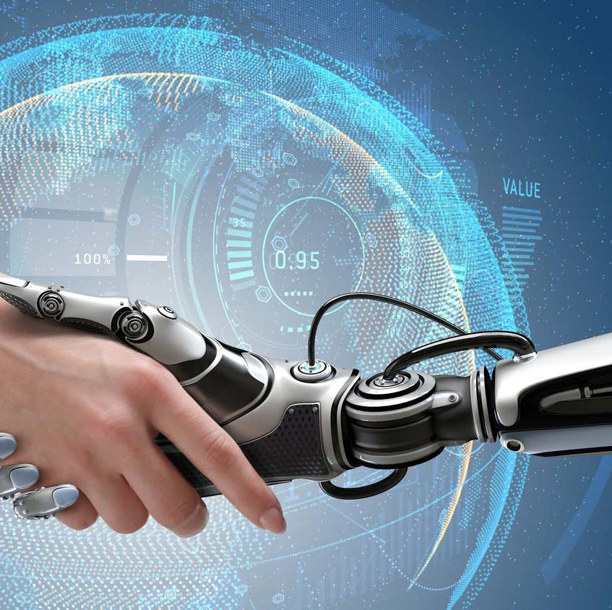
Closing Thoughts
We improved our technical skills and gained real experience
We are proud of the progress we made this semester
Looking forward to expanding these abilities in our future jobs

Slide 11
References
Bah, Mamadu. Maternal Mortality Data Analysis Project. CTEC 128 Final Project, Fall 2025.
Appiah, Prince. NFL Draft Data Analysis Project. CTEC 128 Coursework Submission, Fall 2025.
Black Mamas Matter Alliance. “Advancing Black Maternal Health, Rights, and Justice.” 2023.
Centers for Disease Control and Prevention (CDC). “United States Maternal Mortality Statistics.” 2023.
Course instruction and Python exercises, CTEC 298, Fall 2025.

